Slide 1
Covid 19 Resolving a Potential Crisis Presentation

Slide 2


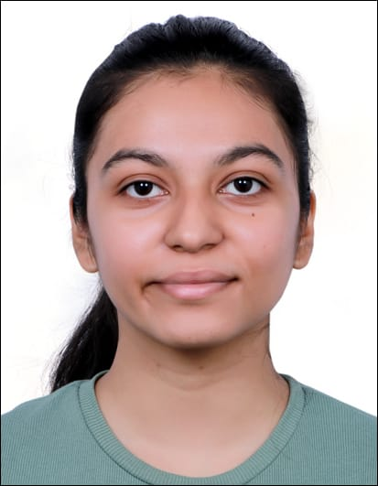


Project analysis slide 2
Team Introduction
NITI PATEL
DEEP SHETA
CHARMY MAKWANA
https://www.linkedin.com/in/niti-patel-42a288167
https://github.com/Deepsheta
https://www.linkedin.com/in/charmy-makwana-12014326b
https://www.linkedin.com/in/deep-sheta-5a79451a1/

Slide 3
Project analysis slide 2
Project Analysis
CLEAN DATA
PROJECT
PRESENT
FIND CORRELATION
ANALYSIS

Slide 4
Project analysis slide 3
Project Analysis
Life as we know it has been turned upside down due to the unprecedented circumstances brought on by covid-19. In 2020, The United States of America’s Gross Domestic Product (GDP) decreased by 2.76 percent, while the forecast initially was 1 percent GDP growth. Many businesses and industries across the world have been severely affected and the need for sustainable measures to help these industries to not just survive but thrive is greater than ever.
Background/
Motivation

Slide 5
Project analysis slide 3
Project Analysis
We can provide governments, businesses, and organizations with practical insight on how to protect their economies and workforce in times of crisis, giving them the confidence and preparedness to brave any adversity thrown their way.
Problem Statement

Slide 6

Project analysis slide 3
Project Analysis
Our plan is to conduct an in-depth analysis of data sources and uncover the correlation between vaccine availability, unemployment levels, and GDP growth. Through this analytics report, we will be able to pinpoint the causes of economic instability and create measures to prevent similar recurrences in future.
Proposal

Slide 7
Project analysis slide 4
Project Flow
Tasks
Clean Data and Analyze it
How to avoid financial in-stability?
Business Objectives
Project Objectives
Implementation Plan
Schedules
As assign
How can government safe Gard the future crisis?
Government/
Organization Objectives
Resolve Potential Crisis
Analyze potential Data
Resources
Web sources

Slide 8
Project analysis slide 3
Analysis Question
?
To what extent does vaccination affect unemployment rates?
What are some effective strategies to address economic crises during pandemics or lockdowns?
How can governments and individuals work together to minimize the economic impact of outbreaks while protecting public health?
Questions

Slide 9
Data sources
https://storage.googleapis.com/covid19-open-data/v3/vaccinations.csv
https://www.macrotrends.net/2632/coronavirus-jobs-lost-vs-previous-recessions
https://www.macrotrends.net/countries/USA/united-states/gdp-gross-domestic-product

Slide 10
Project analysis slide 4
JIRA/Public Repository
https://analysis-project.atlassian.net/jira/core/projects/C1DAFRPC/summary?atlOrigin=eyJpIjoiYjA3NjgwYjAxODE4NDliYmI2MjE0Mzg0Zjc4NjViMjEiLCJwIjoiaiJ9
https://github.com/Deepsheta/Covid--19-descriptive-Analysis-for-resolving-a-potential-crisis
JIRA
GitHub
Project Plan
Data

Slide 11
Thank You

